Slide 1
Graph-Based Behavior Modulation for Enhancing Multi-Agent Navigation
Javier Perera-Lago
Francisco-Jose Campos-Castro
JÉrÔme Guzzi
Rocio Gonzalez-Diaz

Slide 2
PROBLEM TO SOLVE

Slide 3
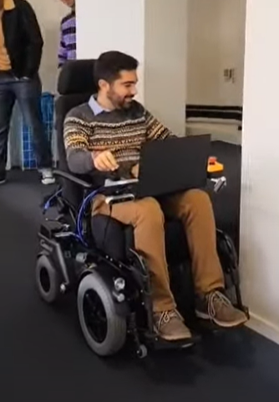
The goal: Autonomous Navigation
Consider a delimited area such as:
A hospital
A nursing home
The agents are autonomous wheelchairs.
The environment can have:
Fixed obstacles (walls, tables, chairs…)
Dynamic obstacles (pedestrians, other wheelchairs…)

Slide 4
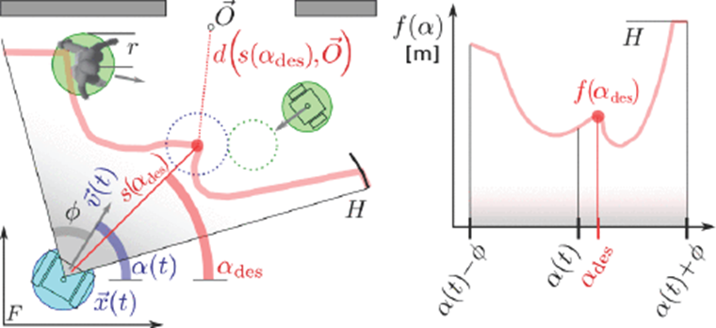
Navigation BEHAVIORS
To reach a target point, each agent follows a behavior.
A BEHAVIOR is a local navigation algorithm that:
Analyses the position and velocity of nearby obstacles
Computes a motion command trying to
reach the target
avoid collisions
There is NO COMMUNICATION between agents.
Some navigation behaviors are Human-Like, ORCA and Social Force

Slide 5
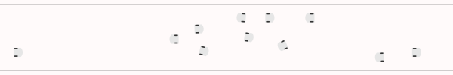
NAVGROUND SIMULATOR
NAVGROUND is a Python library to test navigation behaviors in custom scenarios.
It is easily installable via pip.
All our code, experiments and animations are done with Navground.

Slide 6
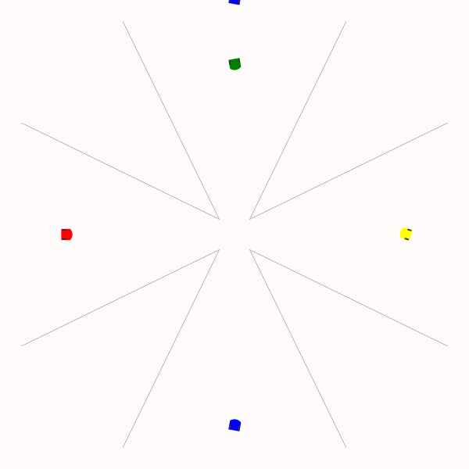
NEGATIVE EVENTS TO AVOID
COLLISIONS
When an agent collides with other agents or with static obstacles
DEADLOCKS
When an agent cannot move because it is blocked by other agents

Slide 7


NEGATIVE EVENTS TO AVOID
The said behaviors cannot prevent collisions in a narrow region.
The said behaviors cannot prevent the formation of obstructive platoons.

Slide 8
OUR PROPOSED SOLUTION

Slide 9
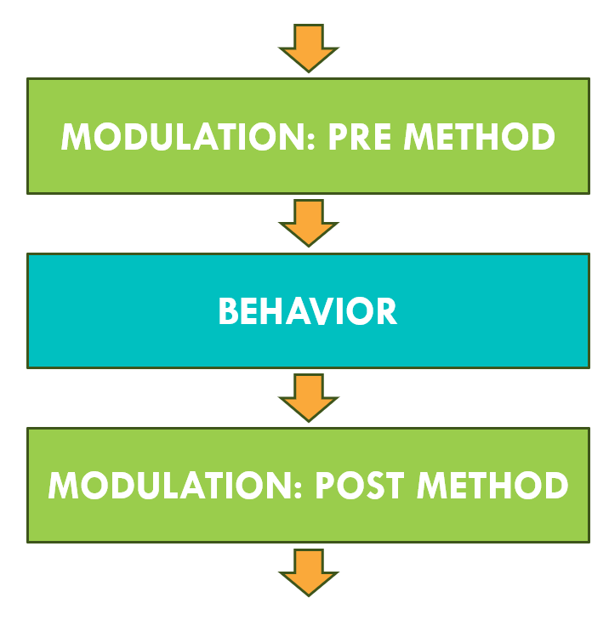
BEHAVIOR MODULATION
A MODULATION is an algorithm complementing the behavior of an agent.
It can act before the behavior:
Changing the agent’s perception of its environment
Changing the agent’s motion parameters
It can act after the behavior:
Changing the computed motion command
However, it does not change the behavior itself.
THE SAME MODULATION CAN BE APPLIED TO MANY DIFFERENT BEHAVIORS

Slide 10
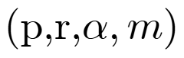
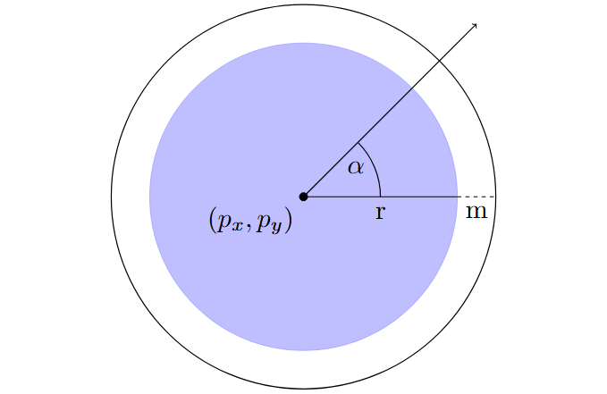
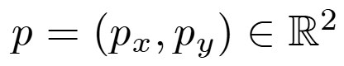
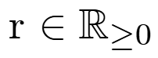
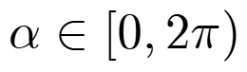
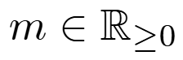
AGENT Representation
An agent is modelled as a tuple , with:
Center
Radius
Orientation
Safety margin

Slide 11
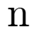
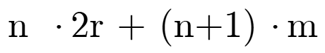
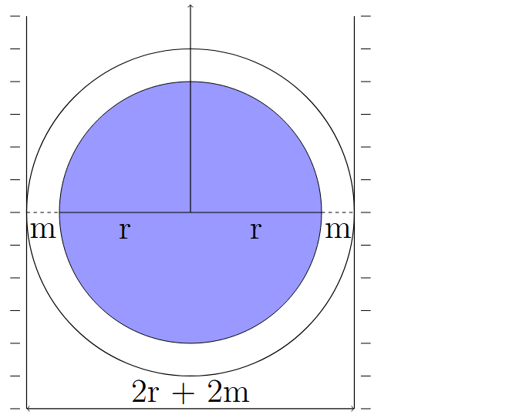
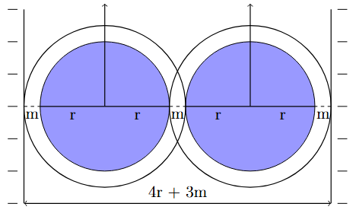
NEEDED SPACE TO PASS BETWEEN OBSTACLES
Consider there are two obstacles in the environment.
If we want agents to pass between them, we need meters.

Slide 12
OUR MODULATION
Given an agent A, the other agents around it are called NEIGHBORS.
We begin dividing the neighbors of A into three groups:
Stuck neighbors:
Their speed is less than 0.01 m/s
Same-flow neighbors
Their speed is greater than 0.01 m/s
Their orientation differs from A’s at most 60º
Opposite-flow neighbors
Their speed is greater than 0.01 m/s
Their orientation differs from A’s more than 60º

Slide 13
OUR MODULATION: NARROW REGIONS
In the first place, we look for NARROW REGIONS.
We create the F-graph F=(V_{F} , E_{F}), where:
Each node in V_{F} correspond to a FIXED obstacle (walls, static obstacles and stuck neighbors)
Two nodes in V_{F} are connected by an edge if their distance is less than 2r + 2m.
If two nodes are connected, it is impossible for A to pass between the obstacles.

Slide 14
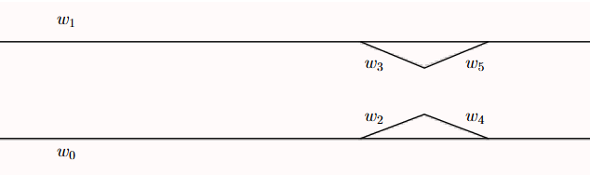
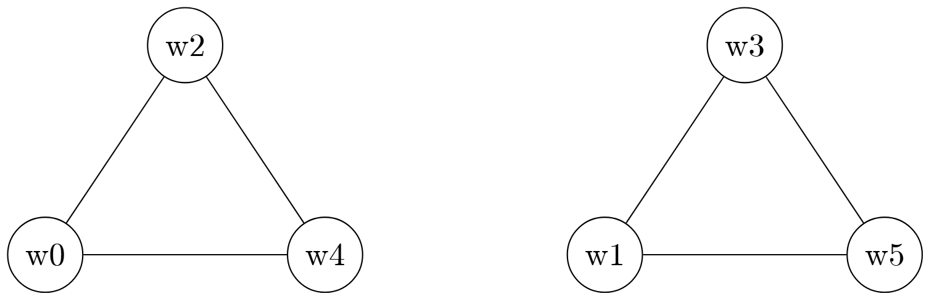
OUR MODULATION: NARROW REGIONS
Example of F-graph:

Slide 15
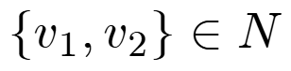
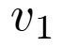
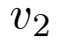
OUR MODULATION: NARROW REGIONS
We now define the set of narrow pairs:
A narrow pair is a pair of obstacles that let one, but not two, agents pass at once.
For each narrow pair , we define its narrow region as:
This is the set of points where A is blocking the narrow area between and .

Slide 16
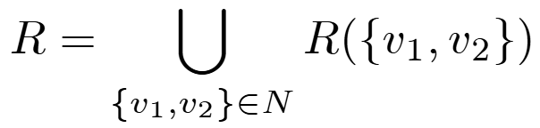
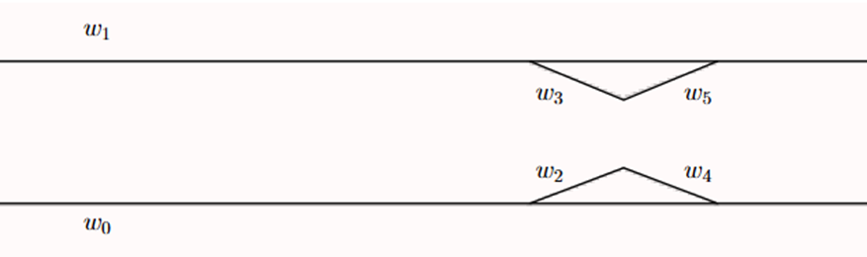

OUR MODULATION: NARROW REGIONS
We define the global narrow region as:
Each connected component of R is called a local narrow region.

Slide 17
OUR MODULATION: NARROW REGIONS
Let R_{min} the closest local narrow region that agent A is looking at.
If an opposite-flow neighbor is in R_{min}, A must stop until R_{min} is empty.
If an opposite-flow neighbor can reach R_{min} before A, A must stop until R_{min} is empty.
In any other case, A can continue normally.
This way, the agents tend to wait each other when arriving to a narrow region.

Slide 18
OUR MODULATION: OBSTRUCTIVE PLATOONS
After checking the narrow regions, we look for OBSTRUCTIVE PLATOONS.
We create the SA-graph SA = (V_{SA},E_{SA}), where:
V_{SA} is formed by agent A and its same-flow neighbors
Two nodes in V_{SA} are connected by an edge if their distance is less than 2r + 2m
The PA-graph PA=(V_{PA},E_{PA}) is the connected component of SA containing node A

Slide 19

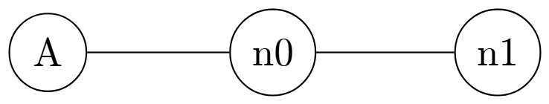
OUR MODULATION: OBSTRUCTIVE PLATOONS
Example of PA-graph:
n1
n0
A

Slide 20
OUR MODULATION: OBSTRUCTIVE PLATOONS
We now create the FPA-graph FPA = (V_{FPA},E_{FPA}), where:
V_{FPA} is the union of V_{F} and V_{PA}
E_{FPA} contains E_{F} and E_{PA}
A node in VF and a node in VPA define an edge if their distance is less than 2r+2m

Slide 21
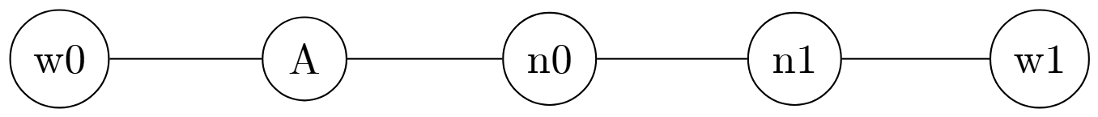
OUR MODULATION: OBSTRUCTIVE PLATOONS
Example of FPA-graph:
w1
n1
n0
A
w0

Slide 22
OUR MODULATION: OBSTRUCTIVE PLATOONS
We say that the platoon of A is blocking the space if we can find two nodes u, v in V_{F} such that:
u and v are in V_{FPA}
u and v are not path-connected in the F-graph
u and v are path-connected in the FPA-graph
That is, the platoon is creating a blockage if it fills the space between two non-adjacent fixed obstacles.

Slide 23
OUR MODULATION: OBSTRUCTIVE PLATOONS
In this example, the platoon of agent A is blocking the corridor.
w1
n1
n0
A
w0

Slide 24
OUR MODULATION: OBSTRUCTIVE PLATOONS
What to do if A’s platoon is blocking the space?
If A finds n platoon neighbors ahead, it multiplies its optimal speed by (3/4)^{n}
If A finds any platoon neighbor at its right, we create a virtual wall in front of A so the navigation behavior tries to avoid it going right.
This way, the agents tend to form a line until the blockage disappears.

Slide 25


OUR MODULATION AVOIDS NEGATIVE EVENTS
Thanks to the modulation, the agents wait each other when reaching a door
Thanks to the modulation, the agents break the blockages and form lanes

Slide 26
EXPERIMENTS

Slide 27
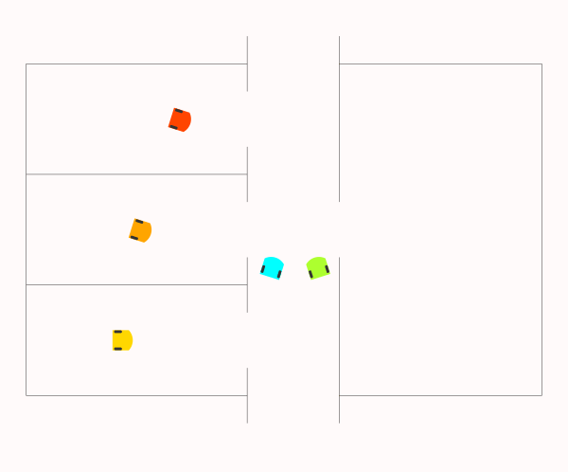
Home scenario
To test this modulation, we designed a custom scenario simulating a building with:
3 individual rooms
A common area
A corridor connecting them

Slide 28
Home scenario
We ran 200 simulations of 120 seconds each one:
In 100 of them, the agents used HL behavior only
In 100 of them, the agents used HL behavior with our modulation
In each simulation, we counted:
Total number of collisions
Nº of agents that get stuck (deadlocks)

Slide 29
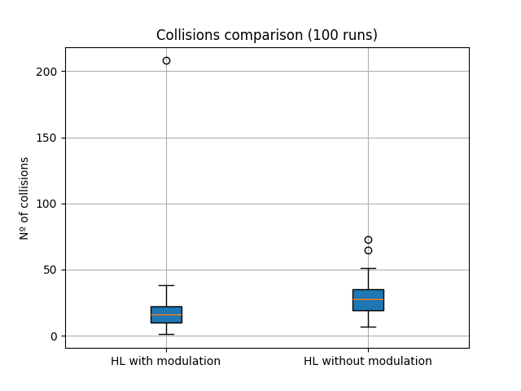
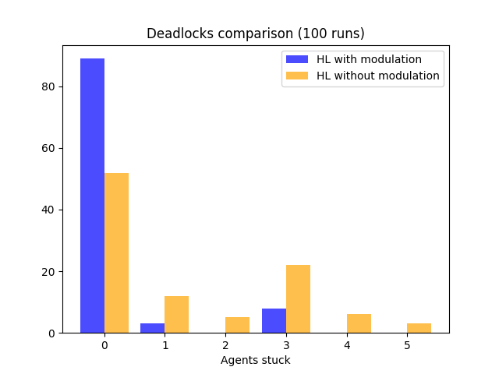
Home scenario
The statistics of collisions and deadlocks improve when we apply our modulation.

Slide 30


THANK YOU SO MUCH FOR YOUR TIME
Code for the modulation
and the experiments

